Slide 1

2020 Pandemic stock analysis
Presented by NBS: Nabeel / Brick / Sal Thursday July 30, 2020

Slide 2

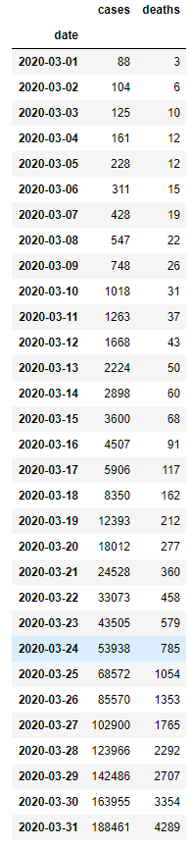
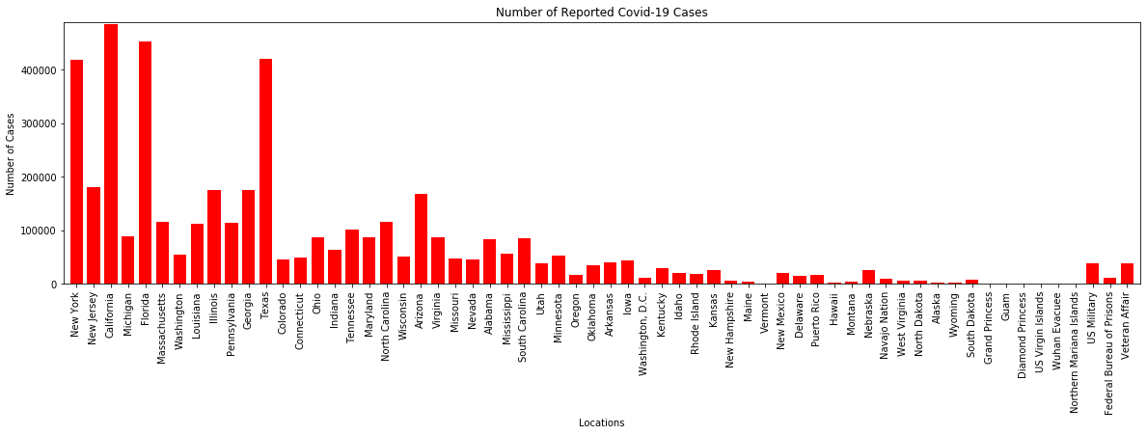
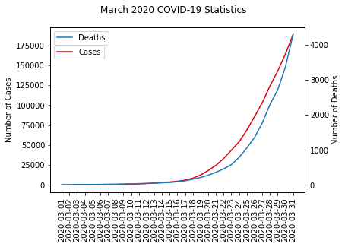
With the growing concern of the ongoing covid-19 pandemic, the fear in the stock market has been growing and continues to be ever present. As you can see from the graph and the # of cases, the concern is valid. Where is the stock going and will it continue to recover as it has oddly done in the past couple months? Nbs is not here to predict where the stock market will be tomorrow, next month, or this time next year. Rather, we are here to show you the current trend of the market in relation to previous epidemics / pandemics

Slide 3
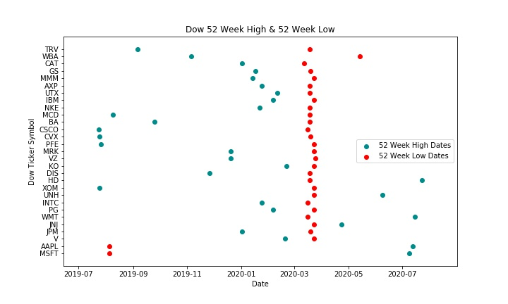
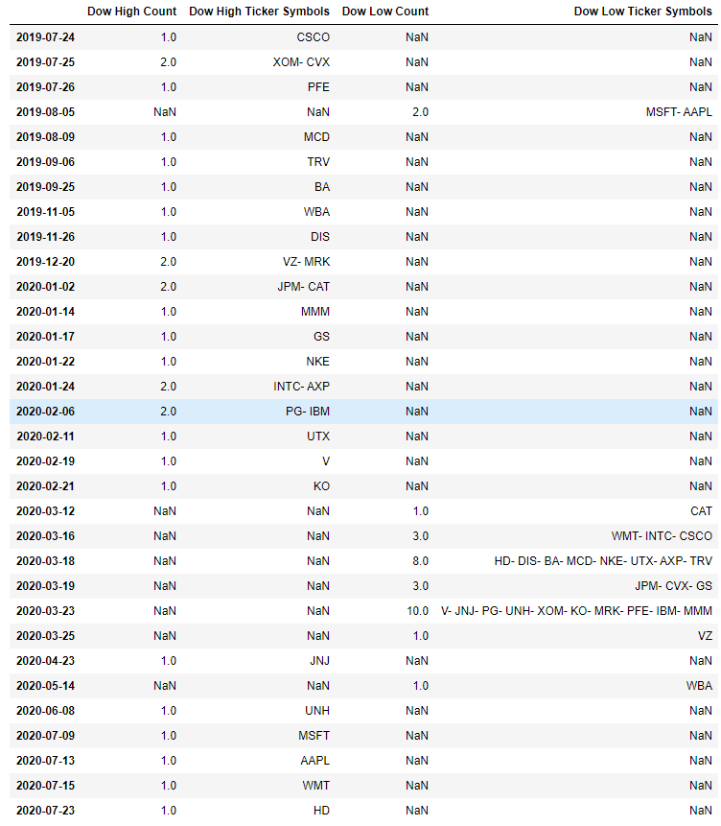
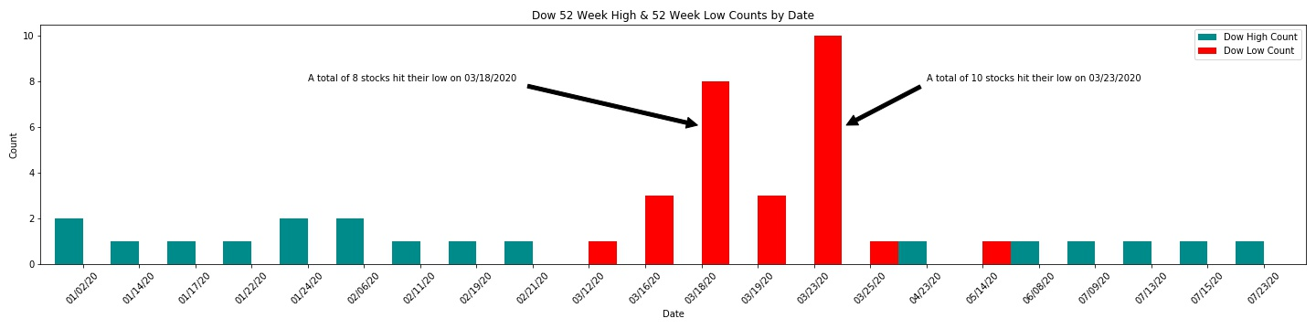
dow 52 Week high and Low data
Filtered / aggregated Data Frame pulled from API
Scatter plot of ticker symbols / dates
Bar graph of counts for 52 Week High/Low by date

Slide 4
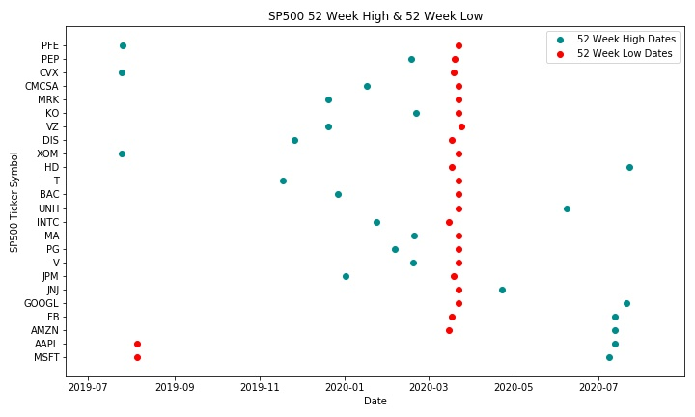
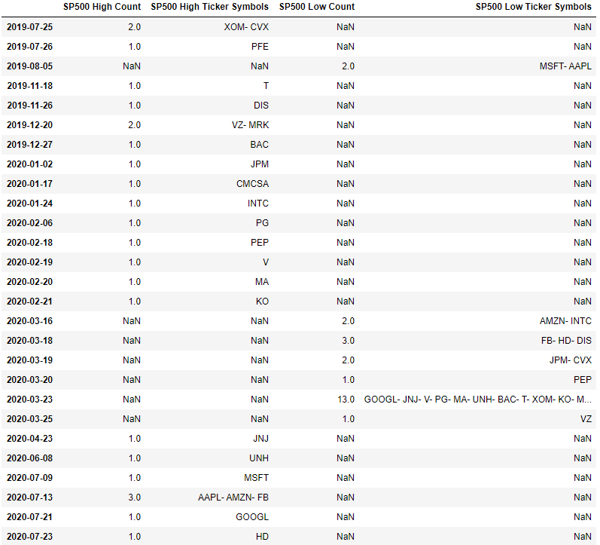
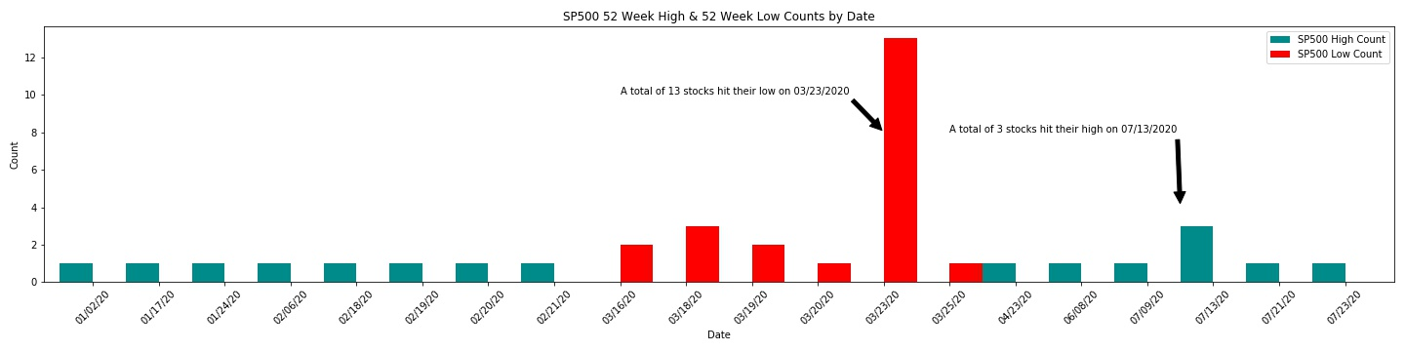
sp500 52 Week high and Low data
Filtered / aggregated Data Frame pulled from API
Scatter plot of ticker symbols / dates
Bar graph of counts for 52 Week High/Low by date

Slide 5
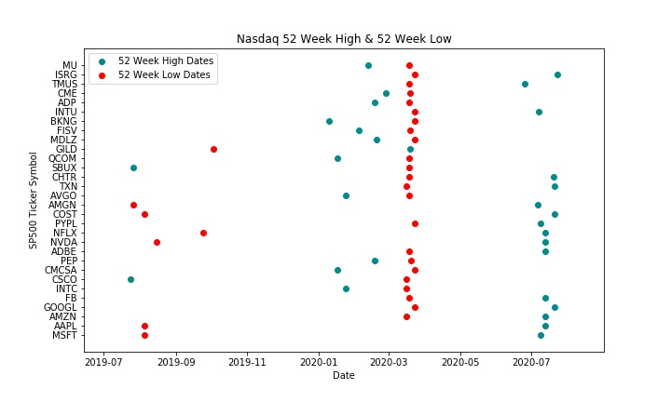
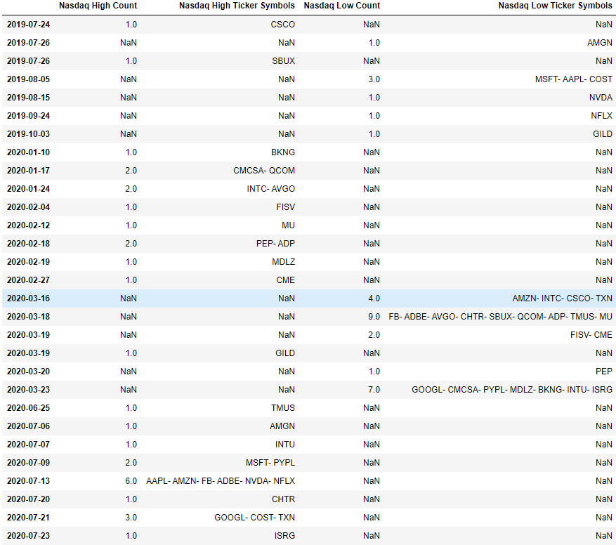
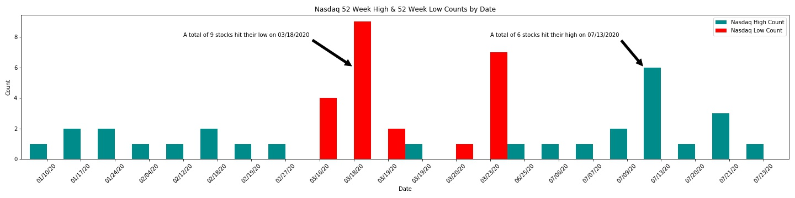
nasdaq 52 Week high and Low data
Filtered / aggregated Data Frame pulled from API
Scatter plot of ticker symbols / dates
Bar graph of counts for 52 Week High/Low by date

Slide 6

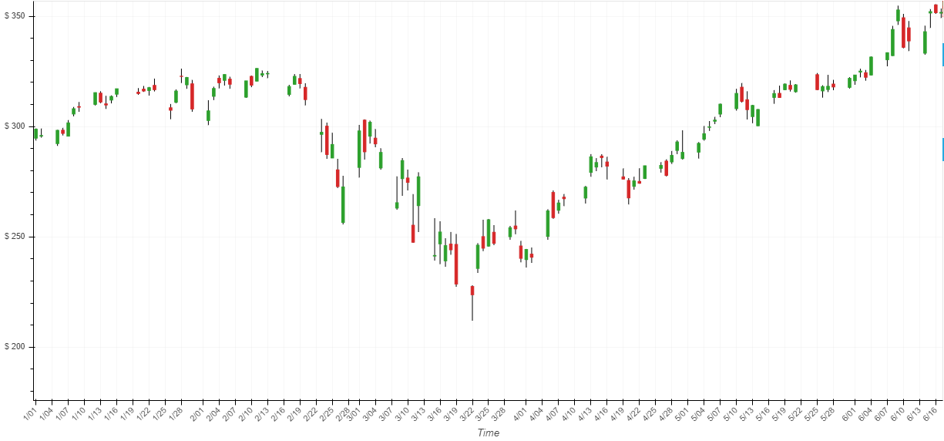
Now Let’s take look at 1 major stock (Apple) and how it has performed since 2019

Slide 7
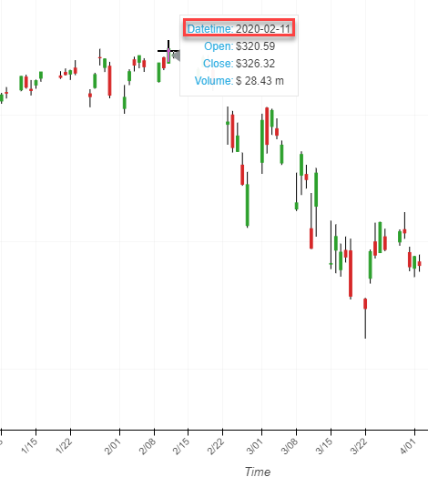
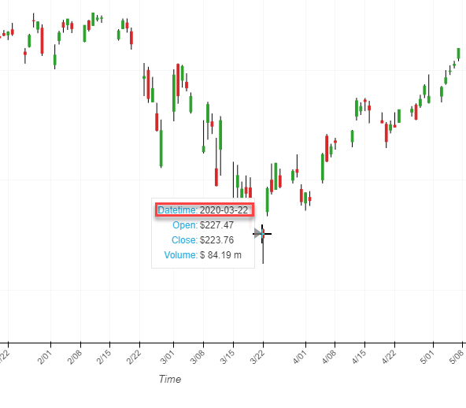
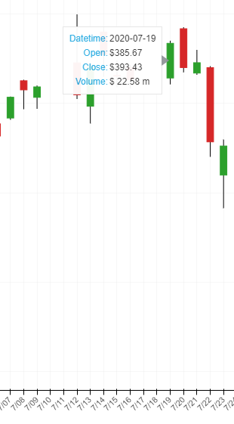
Apple stock during ytd 2020

Slide 8
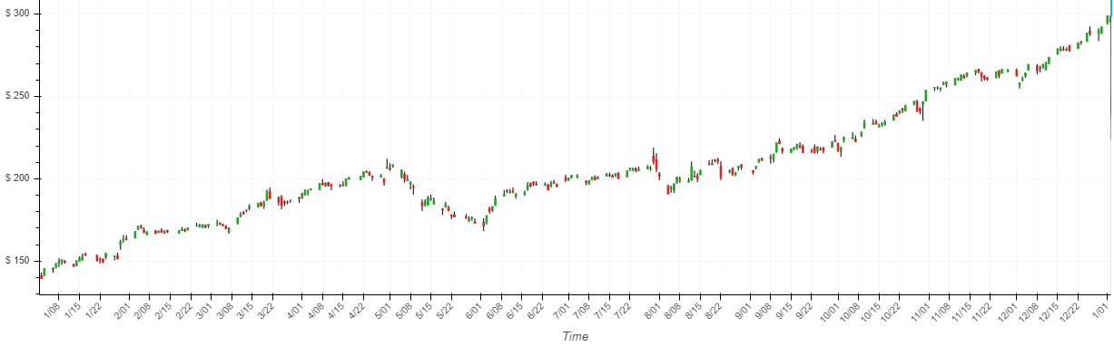
Apple stock during 2019

Slide 9
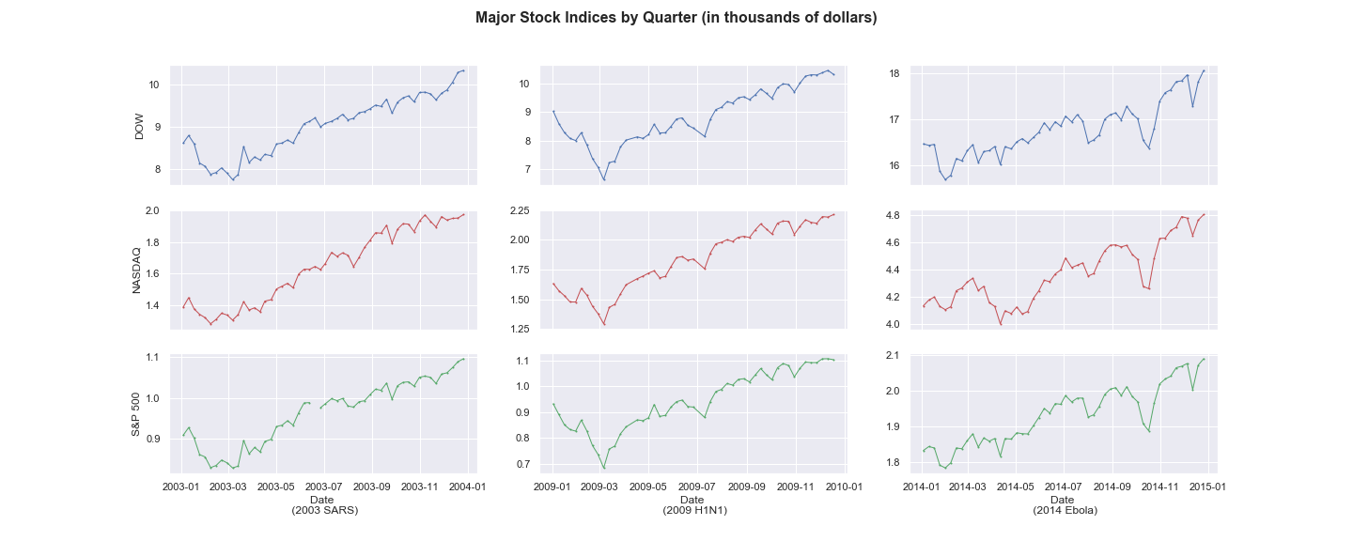
Ready for the big picture?
Let’s look at some timeseries of a few of the biggest pandemics / epidemics that have had an impact on the major stock market indices

Slide 10
In closing... We just want to reiterate that we are in no way predicting the future of the stock market current day. We hope that with the data we extracted and pulled form CSV files and API’s that we were able to show you that historically the stock market recovers from pandemics and epidemics similar to the one we are all experiencing today. Thank you all for your time and attention!

Slide 11

Questions??

